Slide 1
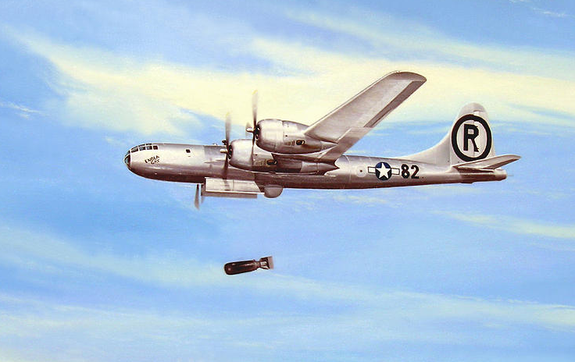
WORLD WAR II: USA vs. JAPAN (1941-1945)

Slide 2
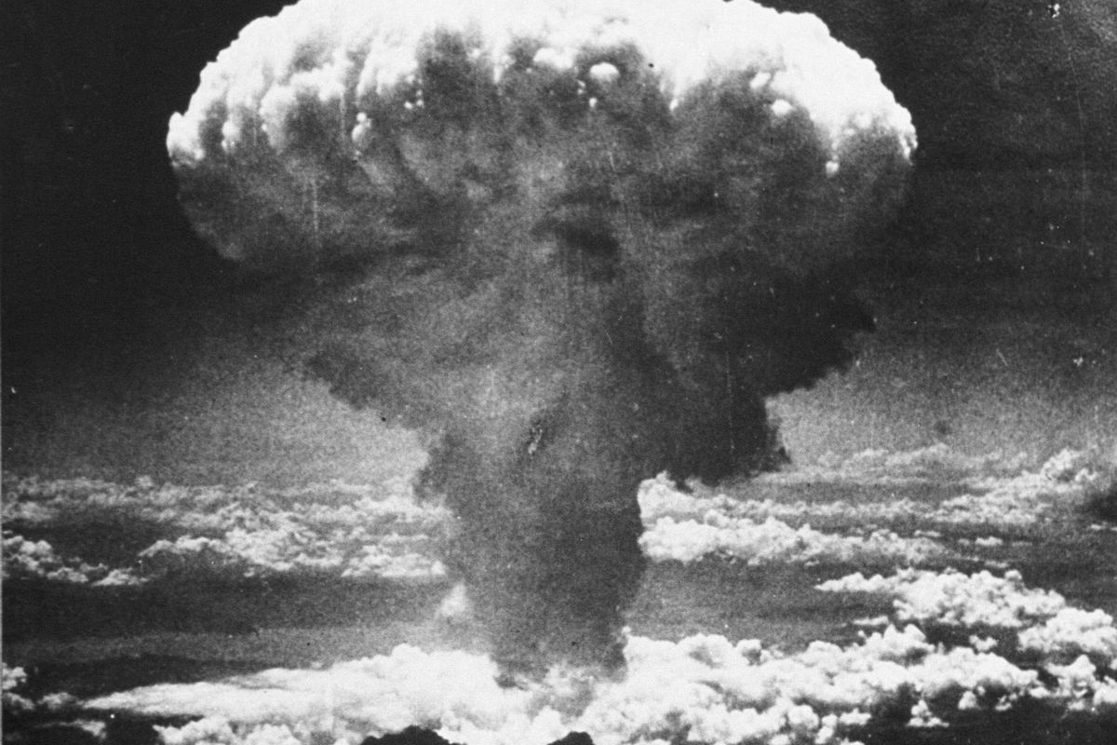
HIROSHIMA & NAGASAKI (1945)

Slide 3
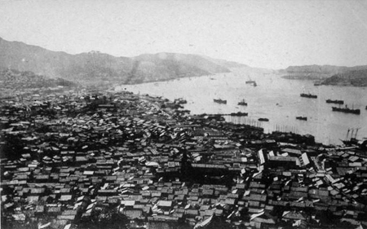
HIROSHIMA & NAGASAKI (1945)

Slide 4
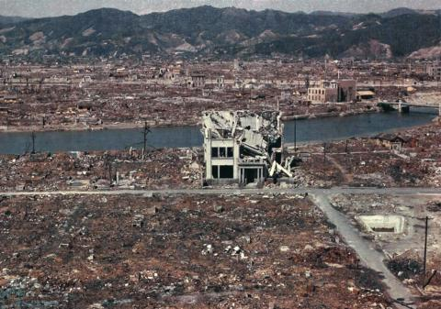
HIROSHIMA & NAGASAKI (1945)

Slide 5
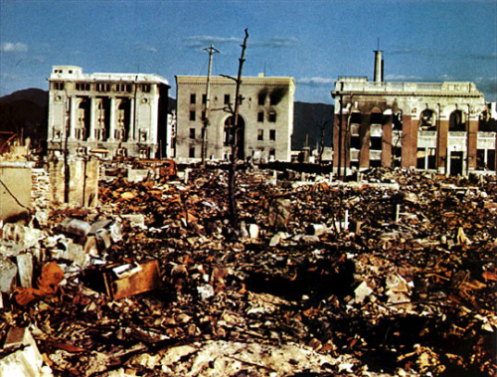
HIROSHIMA & NAGASAKI (1945)

Slide 6
BELL RINGER (TYPE YOUR ANSWERS INTO THE CHAT)
What effects did the atomic bomb have on the citizens of Hiroshima?
Why do you think the United States decided to drop the atomic bomb?
What other options/alternatives do you think should have been considered?
When is such military force necessary?

Slide 7
FOREIGN vs DOMESTIC POLICY
Domestic policy is what happens INSIDE a country.
EX: taxes; police; elections; health care; business
Foreign policy is what happens OUTSIDE a country’s borders. It’s kind of like a blueprint for how a country treats other nations.
EX: foreign aid; treaties; wars; trade

Slide 8
5 GOALS OF FOREIGN POLICY
Maintaining national security
Supporting democracy
Promoting world peace
Providing aid to people in need
Establishing open trade

Slide 9
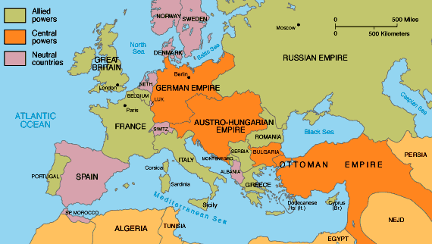
WORLD WAR I

Slide 10
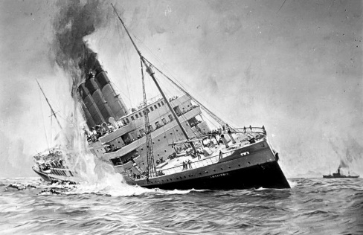
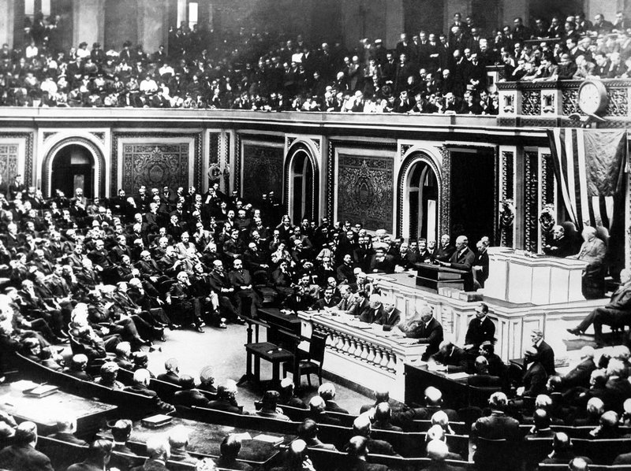
WORLD WAR I
German U-Boats sinking American shipping, including passenger boats like the Lusitania (killing over 1,000 people), helped to bring the US into WWI.
The US declared war on Germany in 1917, and American troops landed in France in 1918, helping to win the war for the Allies.

Slide 11
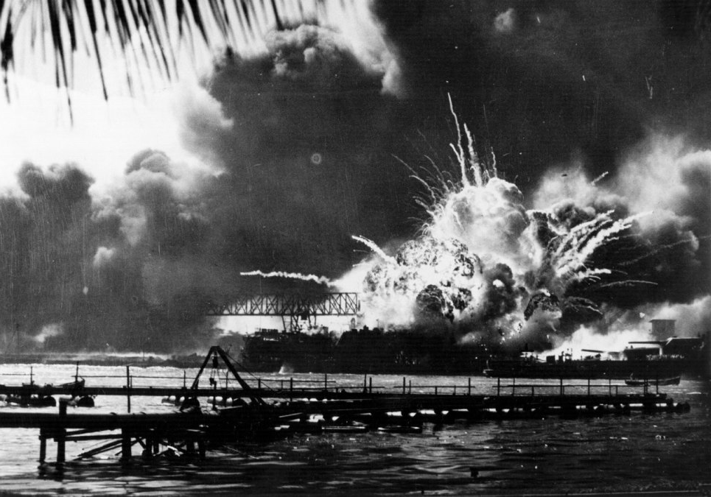
WORLD WAR II
After a period of isolation and economic depression, the US was attacked in 1941 by Japan, who bombed the naval base at Pearl Harbor, killing 2,403 Americans.
The US declared war on Japan in 1941, and Nazi Germany declared war on the US soon after. By 1945, the US and its allies had won the war, but at terrible cost.

Slide 12
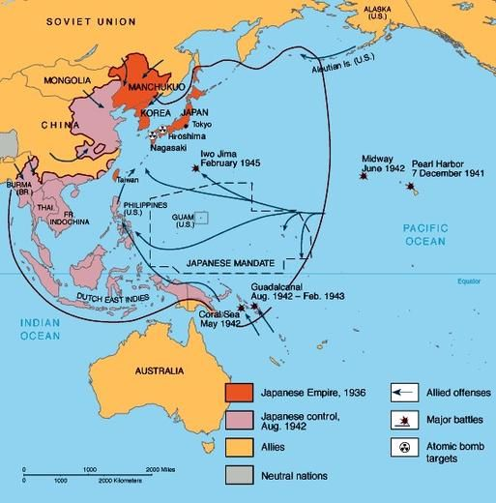
WORLD WAR II

Slide 13
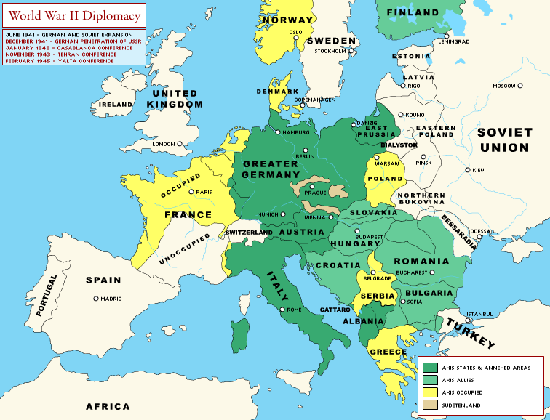
WORLD WAR II

